Slide 1

I/O Ports in AVR
Chapter 4
The AVR microcontroller
and embedded
systems
using assembly and c

Slide 2
Topics
AVR pin out
The structure of I/O pins
I/O programming
Bit manipulating

Slide 3

AVR IO Panel Simulation in AVR Studio 4
The IO Panel Simulation Installer is in folder \Lecture Notes\AVRStudio4\Installer
  Refer to AVRstudio IO simulation.pdf in folder \Lecture Notes\E-Books and Reference for tutorial on how simulate IO in AVR Studio 4.
  Or follow the sequence of next instructions
WinAVR-20100110-install.exe in folder \Lecture Notes\AVRStudio4\Installer\WinAVR-20100110must installed if not done yet.
Then Execute build.bat in folder \Lecture Notes\AVRStudio4\Installer\IO panel Simulator\LCDTest
The drag icon in folder \Lecture Notes\AVRStudio4\Installer\IO panel Simulator\hapsim217 to the taskbar.

Slide 4

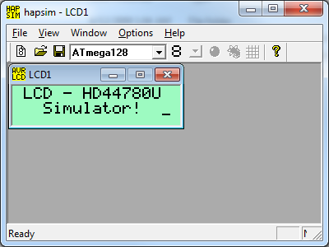
Executing IO Panel Simulation
Everytime you need to execute IO Panel Simulation:
  AVR Studio 4.18 must be executed first.
  The Execute
  If executes successfully, the following window will open.
  Otherwise check if steps in previous page has been taken correctly. Redo if necessary.

Slide 5
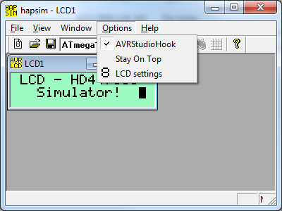
Confirming If HAPSIM Is Hook
To AVR Studio
Press the Option menu and you will find that AVRStudioHook sub-menu is checked as shown below.
By default LCD – HD44780U panel window is opened. You may close this panel and reopen again.

Slide 6
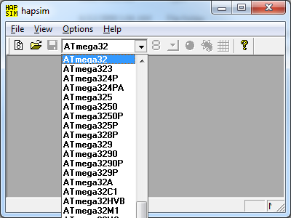
Selecting IO Panel to be virtually connected to ATmega32 microcontroller
Press the icon and scroll down to select ATmega32 as shown below.

Slide 7
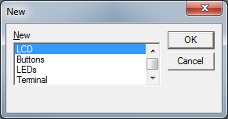
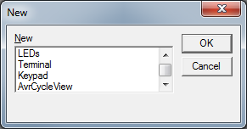
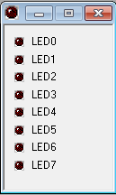
Opening An I/O panel
Press the icon and the following New window will open over the HAPSIM window.
Four I/O panel name will be displayed.
If scroll down you will find more I/O panel name as shown below.
Select the LEDs I/O panel
and the LEDs panel will be
opened asshown in the bottom
right of this page.

Slide 8
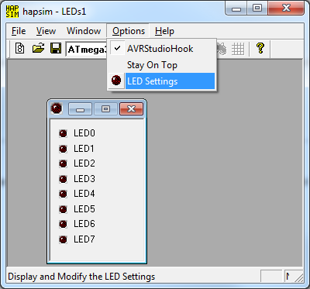
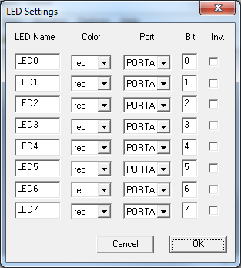
Setting Vitual Connection of
I/O Panel to the AVRStudio
On the Option Menu Select LED Settings and the LED Settings window will opened.
You can change LED Name, Color, virtual connection to the bit # of the port of the microcontroller.
The press OK

Slide 9
Testing the Virtual Connection of the LEDs Panel to AVRStudio Simulator
Open a Atmel AVR Assembler project for the ATmega32 microcontroller and write the program in the following page.
Build and Run the program.
Watch The LED panel at HIPSIM window
You will see that the program cause the LED panel displays a 8 bit binary count up.

Slide 10
Program to test LED panel
.include "M32def.inc"
.org 0
ldi r20,high(RAMEND)
out sph,r20
ldi r20,low(RAMEND)
out spl,r20
ldi r20,0xff;Set Port A as output
out ddra,r20
ldi r20,0x0 ;r0 <-- 0
loop:
inc r20 ;r0 <-- r0+1
out porta,r20 ;Port A<-R20
call delay1s ;delay
rjmp loop
delay1s:
ldi r16,200
delay1s0:
ldi r17,0xff
delay1s1:
dec r17
brne delay1s1
dec r16
brne delay1s0
ret

Slide 11
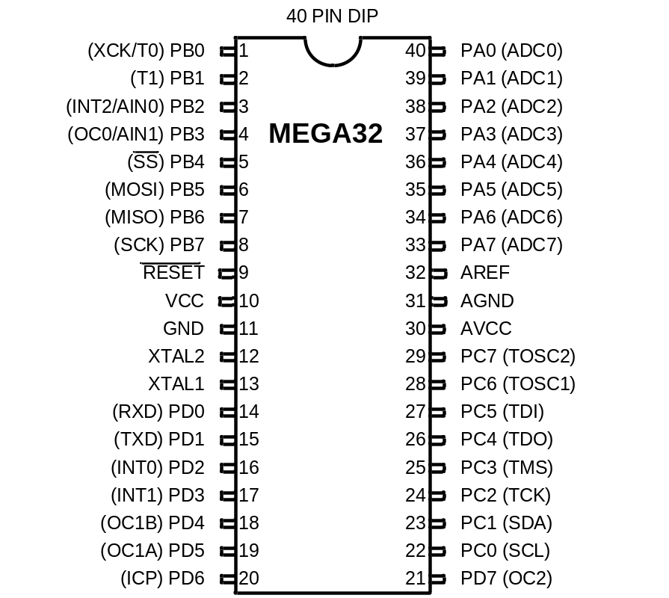

ATmega16/mega32 pinout
Vital Pins:
  Power
    VCC
    Ground
  Crystal
    XTAL1
    XTAL2
  Reset
I/O pins
  PORTA, PORTB, PORTC, and PORTD
Internal ADC pins
  AREF, AGND, AVCC
+5 ^{V}
+5 ^{V}
+5 ^{V}

Slide 12
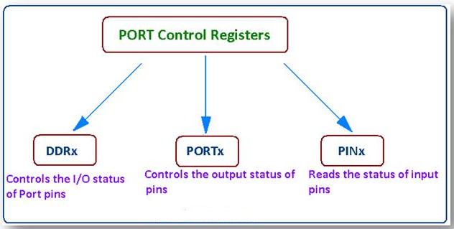
ATMega32 I/O Port Registers
There are three registers associated with Input/ Output Ports in AVR.

Slide 13
Register Addresses for ATmega32 Ports
Port | IO | SRAM | Usage
 | Address | Address
PORTA | $1B | $3B | Output
DDRA | $1A | $3A | Direction
PINA | $19 | $39 | Input
PORTB | $18 | $38 | Output
DDRB | $17 | $37 | Direction
PINB | $16 | $36 | Input
PORTC | $15 | $35 | Output
DDRC | $14 | $34 | Direction
PINC | $13 | $33 | Input
PORTD | $12 | $32 | Output
DDRD | $11 | $31 | Direction
PIND | $10 | $30 | Input

Slide 14
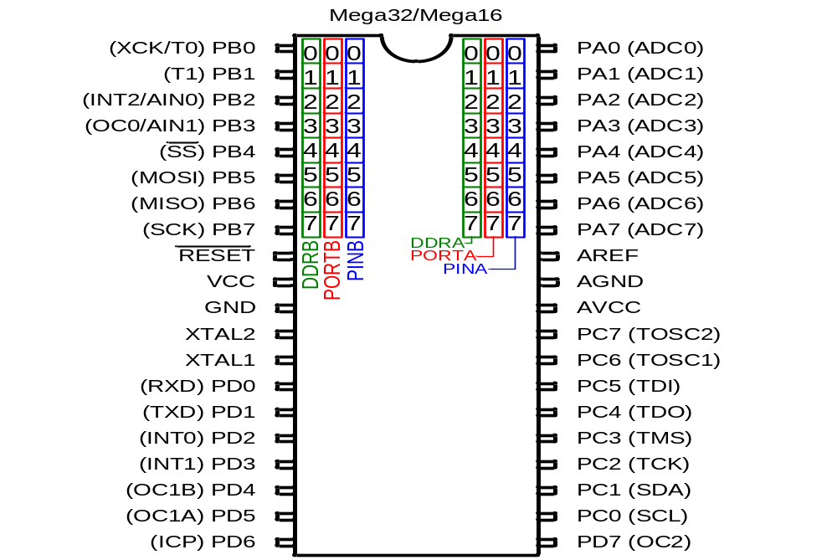
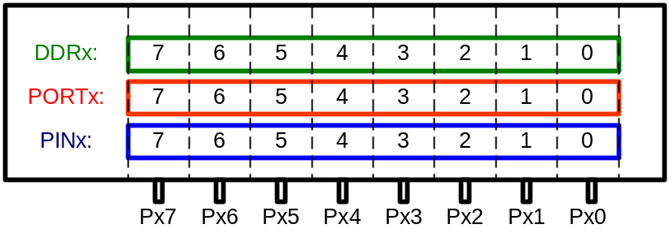
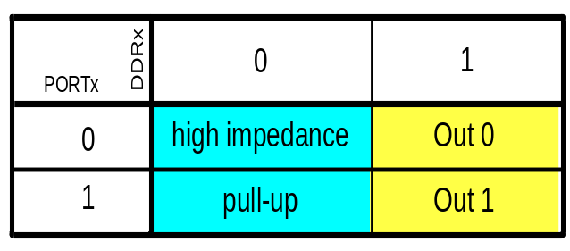
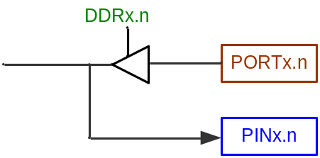
The structure of IO pins

Slide 15
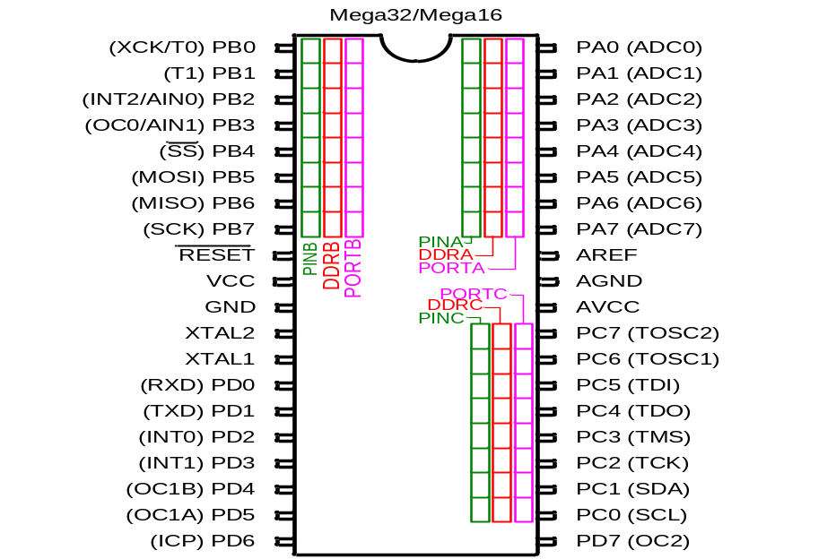
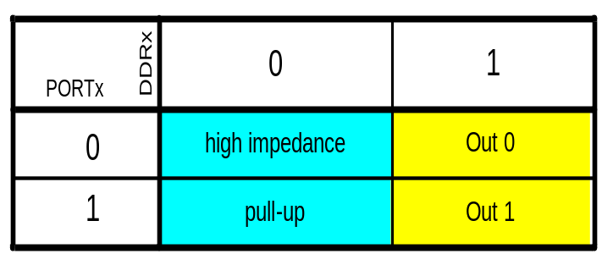
Example 1
Write a program that makes all the pins of PORTA one.
DDRA:
1 1 1 1 1 1 1 1
PORTA:
1 1 1 1 1 1 1 1
.INCLUDE “M32DEF.INC”
LDI R20,0xFF ;R20 = 11111111 (binary)
OUT PORTA,R20 ;PORTA = R20
OUT DDRA,R20 ;DDRA = R20

Slide 16
Example 2
The following code will toggle all 8 bits of Port B forever with some time delay between “on” and “off” states:
LDI R16,0xFF ;R16 = 0xFF = 0b11111111
OUT DDRB,R16 ;make Port B an output port (1111 1111)
L1: LDI R16,0x55 ;R16 = 0x55 = 0b01010101
OUT PORTB,R16 ;put 0x55 on port B pins
CALL DELAY
LDI R16,0xAA ;R16 = 0xAA = 0b10101010
OUT PORTB,R16 ;put 0xAA on port B pins
CALL DELAY
RJMP L1

Slide 17

Example 3
A 7-segment is connected to PORTA. Display 1 on the 7-segment.
DDRC:
1 1 1 1 1 1 1 1
ATmega32
PORTC:
0 0 0 0 0 1 1 0
0
.INCLUDE “M32DEF.INC”
LDI R20,0x06 ;R20 = 00000110 (binary)
OUT PORTC,R20 ;PORTC = R20
LDI R20,0xFF ;R20 = 11111111 (binary)
OUT DDRC,R20 ;DDRC = R20
L1: RJMP L1
8
5
6
1
PORTC
4
2
3

Slide 18

Example 4
A 7-segment is connected to PORTA. Display 3 on the 7-segment.
DDR:
1 1 1 1 1 1 1 1
ATmega32
PORTC:
0 1 0 0 1 1 1 1
0
.INCLUDE “M32DEF.INC”
LDI R20,0x4F ;R20 = 01001111 (binary)
OUT PORTC,R20 ;PORTC = R20
LDI R20,0xFF ;R20 = 11111111 (binary)
OUT DDRC,R20 ;DDRC = R20
L1: RJMP L1
8
5
6
1
PORTC
4
2
3

Slide 19
Example 5: Input
The following code gets the data present at the pins of port C and sends it to port B indefinitely, after adding the value 5 to it:
.INCLUDE "M32DEF.INC"
LDI R16,0x00 ;R16 = 00000000 (binary)
OUT DDRC,R16 ;make Port C an input port
LDI R16,0xFF ;R16 = 11111111 (binary)
OUT DDRB,R16 ;make Port B an output port(1 for Out)
L2: IN R16,PINC ;read data from Port C and put in R16
LDI R17,5
ADD R16,R17 ;add 5 to it
OUT PORTB,R16 ;send it to Port B
RJMP L2 ;continue forever

Slide 20
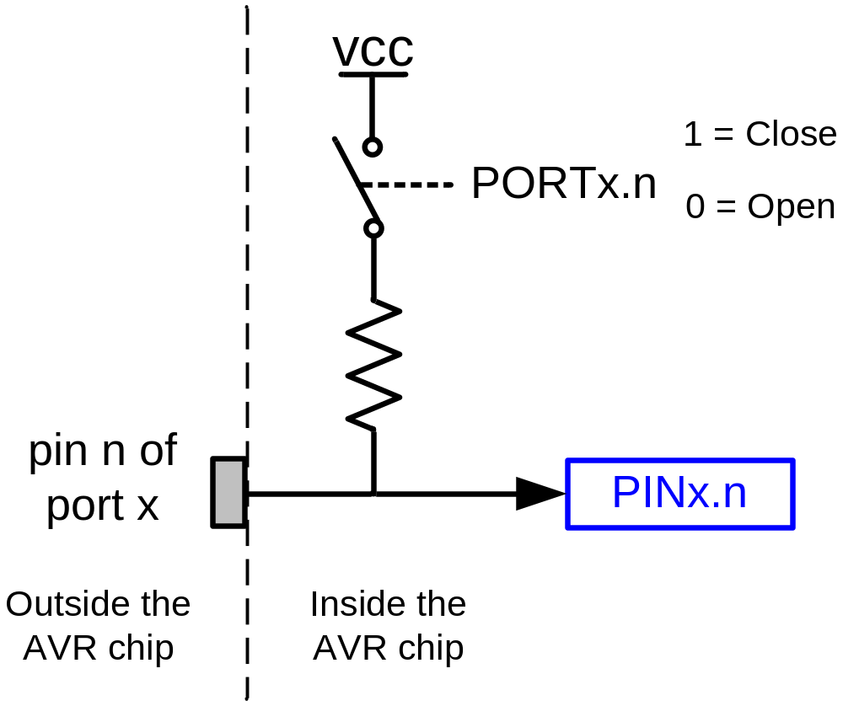
Pull-up resistor

Slide 21
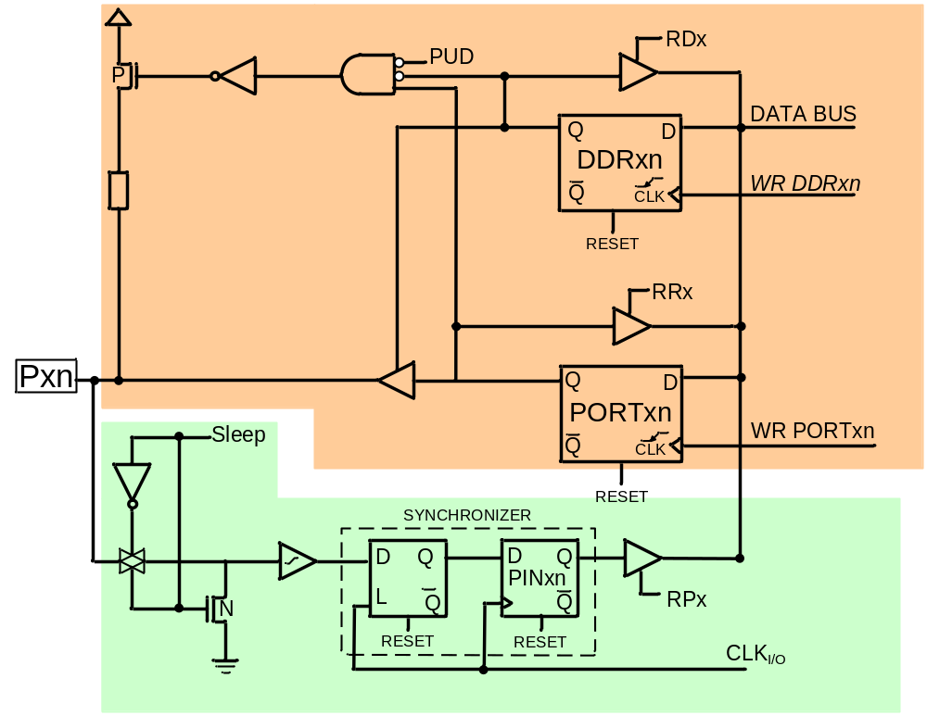
The structure of I/O pins
DDRx.n
OUTPUT
PORTx.n
PINx.n
INPUT

Slide 22
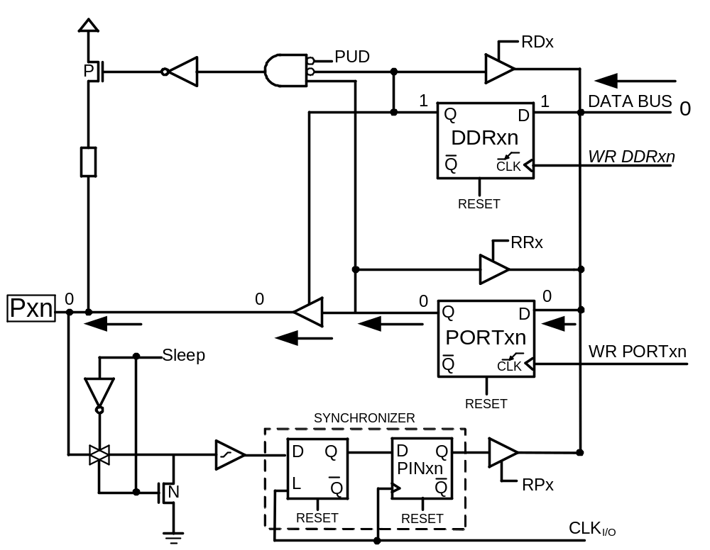
Out 0

Slide 23
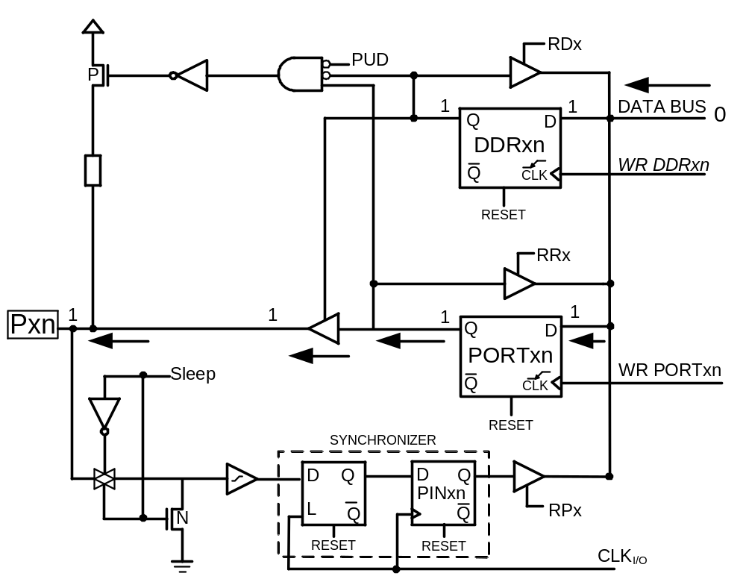
Out 1

Slide 24
Example 6
Write a program that continuously sends out to Port C the alternating values of 0x55 and 0xAA.
  .INCLUDE "M32DEF.INC"
  LDI R16,0xFF ;R16 = 11111111 (binary)
  OUT DDRC,R16 ;make Port C an output port
  L1: LDI R16,0x55 ;R16 = 0x55
  OUT PORTC,R16 ;put 0x55 on Port C pins
  LDI R16,0xAA ;R16 = 0xAA
  OUT PORTC,R16 ;put 0xAA on Port C pins
  RJMP L1

Slide 25
The structure of IO pins

Slide 26
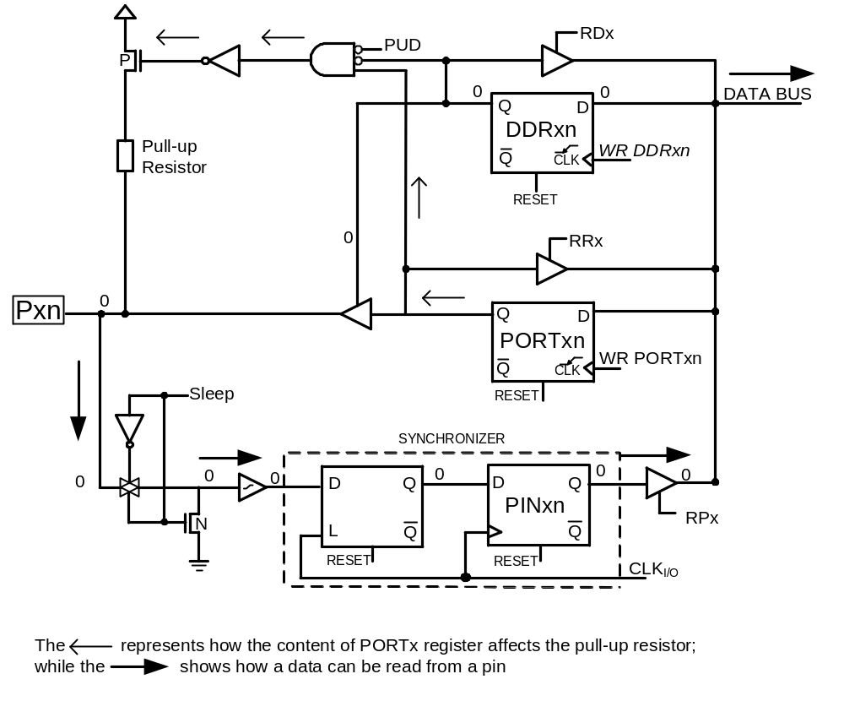
Input (Tri-state vs. pull up)

Slide 27
Example 7
Write a program that reads from port A and writes it to port B.
.INCLUDE “M32DEF.INC”
LDI R20,0x0 ;R20 = 00000000 (binary)
OUT DDRA,R20 ;DDRA = R20
LDI R20,0xFF ;R20 = 11111111 (binary)
OUT DDRB,R20 ;DDRB = R20
L1: IN R20,PINA ;R20 = PINA
OUT PORTB,R20 ;PORTB = R20
RJMP L1

Slide 28
Synchronizer delay
Example: Port A is configured first as an input port by writing all Os to register DDRA, and then data is received from Port A and saved in a RAM location:
  .INCLUDE "M32DEF.INC"
  .EQU MYTEMP 0x100 ;save it here
  LDI R16, 0x00 ;R16 = 00000000 (binary)
  OUT DDRA,R16 ;make Port A an input port (0 for In)
  NOP ;synchronizer delay
  IN R16,PINA ;move from pins of Port A to R16
  STS MYTEMP,R16 ;save it in MYTEMP
The input circuit of the AVR has a delay of 1 clock cycle. In other words, the PIN register represents the data that was present at the pins one clock ago. In the above code, when the instruction "IN Rl6, PINA" is executed, the PINA register contains the data, which was present at the pins one clock before. That is why the NOP is put before the "IN Rl6, PINA" instruction. (If the NOP is omitted, the read data is the data of the pins when the port was output.

Slide 29
Example 8 (1/2)
Write a test program for the AVR chip to toggle all the bits of PORTB, PORTC, and PORTD every 1/4 of a second. Assume a crystal frequency of 1 MHz.
Solution:
.INCLUDE "M32DEF.INC"
LDI R16, HIGH(RAMEND)
OUT SPH, R16
LDI R16, LOW(RAMEND)
OUT SPL, R16 ;initialize stack pointer
L3:
  LDI R16, 0xFF
  OUT DDRB, R16
  OUT DDRC, R16
  OUT DDRD, R16
  LDI R16, 0x55
  OUT PORTB, R16
  OUT PORTC, Rl6
  OUT PORTD, Rl6
  CALL DELAY
  COM R16
  RJMP L3

Slide 30
Example 8 (2/2)
    ;---------------1/4 SECOND DELAY
    DELAY:
    LDI R21, 200
    D1: LDI R22, 250
    D2: NOP
    NOP
    DEC R22
    BRNE D2
    DEC R21
    BRNE D1
    RET
Calculations:
1/1MHz =1 μs ⇒ 1 MC = 1 μs
Delay = 200 x 250 x 5 x 1 μs = 250,000 μs (If we include the overhead, we will have 250,608 us.

Slide 31
I/O bit manipulation programming

Slide 32
SBI and CBI instructions
SBI (Set Bit in IO register)
SBI A,b ; I/O(A,b) ← 1 where 0 ≤ A ≤ 31, 0 ≤ b ≤ 7
  SBI ioReg, bit ;ioReg.bit = 1
  Examples:
    SBI PORTD,0 ;PORTD.0 = 1
    SBI DDRC,5 ;DDRC.5 = 1
CBI (Clear Bit in IO register)
CBI A,b ; I/O(A,b) ← 0 where 0 ≤ A ≤ 31, 0 ≤ b ≤ 7
  CBI ioReg, bit ;ioReg.bit = 0
  Examples:
    CBI PORTD,0 ;PORTD.0 = 0
    CBI DDRC,5 ;DDRC.5 = 0

Slide 33
Example
Write a program that toggles PORTA.4 continuously.
.INCLUDE “M32DEF.INC”
SBI DDRA,4
L1: SBI PORTA,4
CBI PORTA,4
RJMP L1

Slide 34
Example 4-2
An LED is connected to each pin of Port D. Write a program to turn on each LED from pin D0 to pin D7. Call a delay module before turning on the next LED.
.INCLUDE "M32DEF.INC"
LDI R20, 0xFF
OUT DDRD, R20 ;make PORTD an output port
SBI PORTD,0 ;set bit PD0
CALL DELAY ;delay before next one
SBI PORTD,1 ;turn on PD1
CALL DELAY ;delay before next one
SBI PORTD,2 ;turn on PD2
CALL DELAY
SBI PORTD,3
CALL DELAY
SBI PORTD,4
CALL DELAY
SBI PORTD,5
CALL DELAY
SBI PORTD,6
CALL DELAY
SBI PORTD,7
CALL DELAY

Slide 35
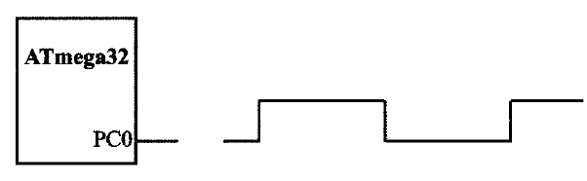
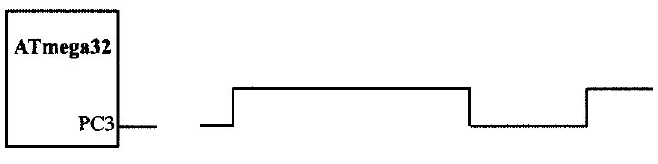
Example 4-3 (1/3)
Write the following programs:
(a) Create a square wave of 50% duty cycle on bit 0 of Port C.
(b) Create a square wave of66% duty cycle on bit 3 of Port C.
duty cycle = 50% (T_{ON} = T_{OFF})
duty cycle = 66% (T_{ON} = 2T_{OFF})

Slide 36
Example 4-3 (2/3)
Solution: (a)
.INCLUDE "M32DEF. INC“
LDI R20, HIGH(RAMEND)
OUT SPH, R20
    LDI R20, LOW (RAMEND)
    OUT SPL, R20 ;initialize stack pointer
    SBI DDRC, 0 ;set bit 0 of DDRC (PCO = Output)
HERE: SBI PORTC, 0 ;set to HIGH PCO (PCO = 1)
    CALL DELAY ;call the delay subroutine
    CBI PORTC, 0 ; PCO = 0
    CALL DELAY
RJMP HERE ; keep doing it

Slide 37
Example 4-3 (3/3)
Solution: (b)
.INCLUDE "M32DEF. INC“
LDI R20, HIGH(RAMEND)
OUT SPH, R20
    LDI R20, LOW (RAMEND)
    OUT SPL, R20 ;initialize stack pointer
SBI DDRC, 3 ;set bit 3 of DDRC (PC3 = out)
HERE: SBI PORTC, 3 ;set to HIGH PC3 (PC3 = 1)
CALL DELAY ;call the delay subroutine
CALL DELAY ;call the delay subroutine
CBI PORTC, 3 ;PC3 = 0
CALL DELAY
RJMP HERE ;keep doing it

Slide 38
SBIC and SBIS
SBIC (Skip if Bit in IO register Cleared)
SBIC A,b ; 0 ≤ A ≤ 31, 0 ≤ b ≤ 7
  SBIC ioReg, bit ; if (ioReg.bit = 0) skip next instruction
  Example:
    SBIC PORTD,0 ;skip next instruction if PORTD.0=0
    INC R20
    LDI R19,0x23
SBIS (Skip if Bit in IO register Set)
SBIS A,b ; 0 ≤ A ≤ 31, 0 ≤ b ≤ 7
  SBIS ioReg, bit ; if (ioReg.bit = 1) skip next instruction
  Example:
    SBIS PORTD,0 ;skip next instruction if PORTD.0=1
    INC R20
    LDI R19,0x23

Slide 39
Example 4-4
Write a program to perform the following:
  (a) Keep monitoring the PB2 bit until it becomes HIGH;
  (b) When PB2 becomes HIGH, write value $45 to Port C, and also send a HIGH-to-LOW pulse to PD3.
.INCLUDE "M32DEF.INC"
CBI DDRB, 2 ;make PB2 an input
SBI PORTB,2
LDI R16, 0xFF
OUT DDRC, R16 ;make Port C an output port
SBI DDRD, 3 ;make PD3 an output
AGAIN: SBIS PINB, 2 ;Skip if Bit PB2 is HIGH
RJMP AGAIN ;keep checking if LOW
LDI R16, 0x45
OUT PORTC, R16 ;write 0x45 to port C
SBI PORTD, 3 ;set bit PD3 (H-to-L)
CBI PORTD, 3 ;clear bit PD3
HERE: RJMP HERE

Slide 40
Example 4-5 (1/2)
Assume that bit PB3 is an input and represents the condition of a door alarm. If it goes LOW, it means that the door is open. Monitor the bit continuously. Whenever it goes LOW, send a HIGH-to-LOW pulse to port PCS to turn on a buzzer.
Solution:
  .INCLUDE "M32DEF. INC"
  CBI DDRB, 3 ;make PB3 an input
  SBI DDRC, 5 ;make PC5 an output
  HERE: SBIC PINB, 3 ;keep monitoring PB3 for HIGH
  RJMP HERE ;stay in the loop
  SBI PCRTC, 5 ; make PC5 HIGH
  CBI PCRTC, 5 ;make PCS LOW for H-to-L
  RJMP HERE

Slide 41
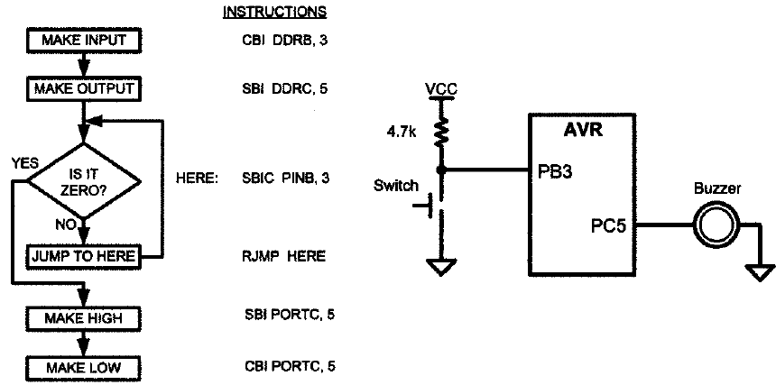
Example 4-5 (2/2)

Slide 42
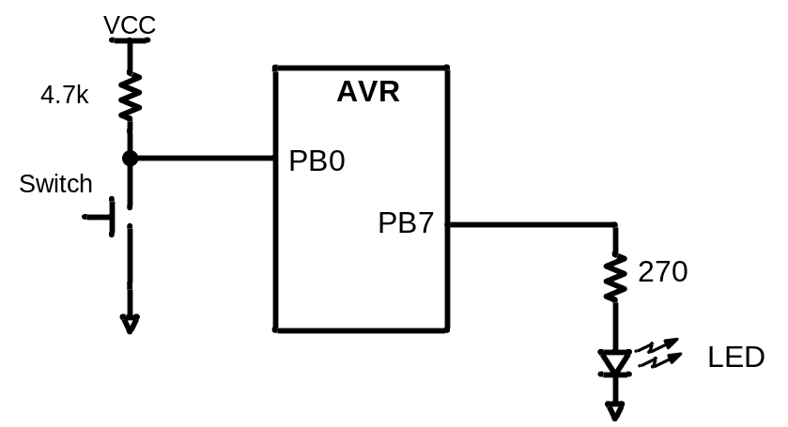
Example 4-8
A switch is connected to pin PB0 and an LED to pin PB7. Write a program to get the status of SW and send it to the LED.
.INCLUDE "M32DEF.INC"
CBI DDRB,0 ;make PB0 an input
SBI DDRB,7 ;make PB7 an output
AGAIN: SBIC PINB,0 ;skip next if PB0 is clear
RJMP OVER ;(JMP is OK too)
CBI PORTB,7
RJMP AGAIN ;we can use JMP too
OVER: SBI PORTB,7
RJMP AGAIN ;we can use JMP too

Slide 43
